Slide 1


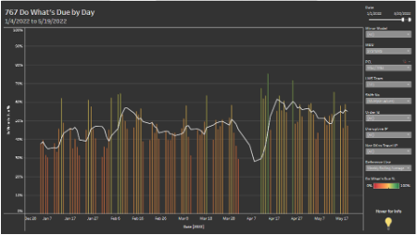
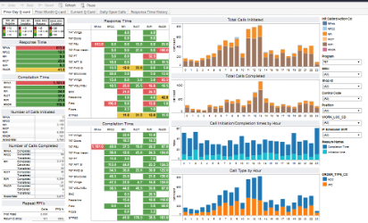
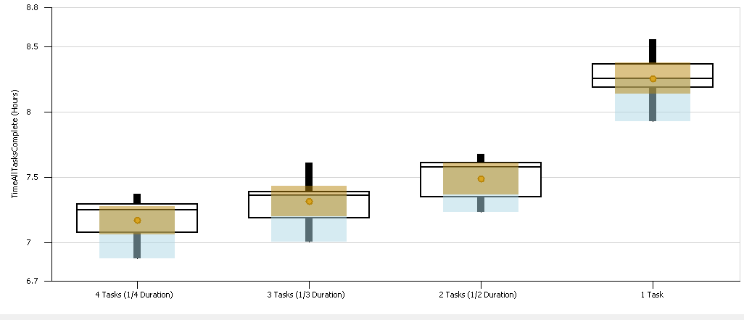
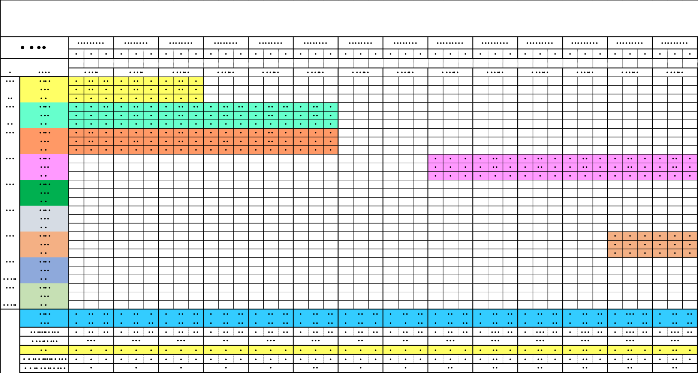
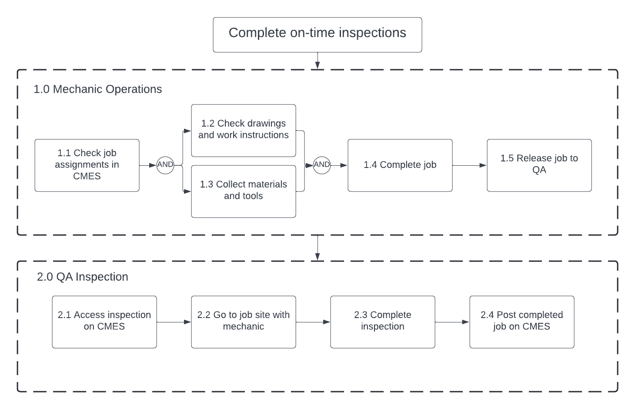
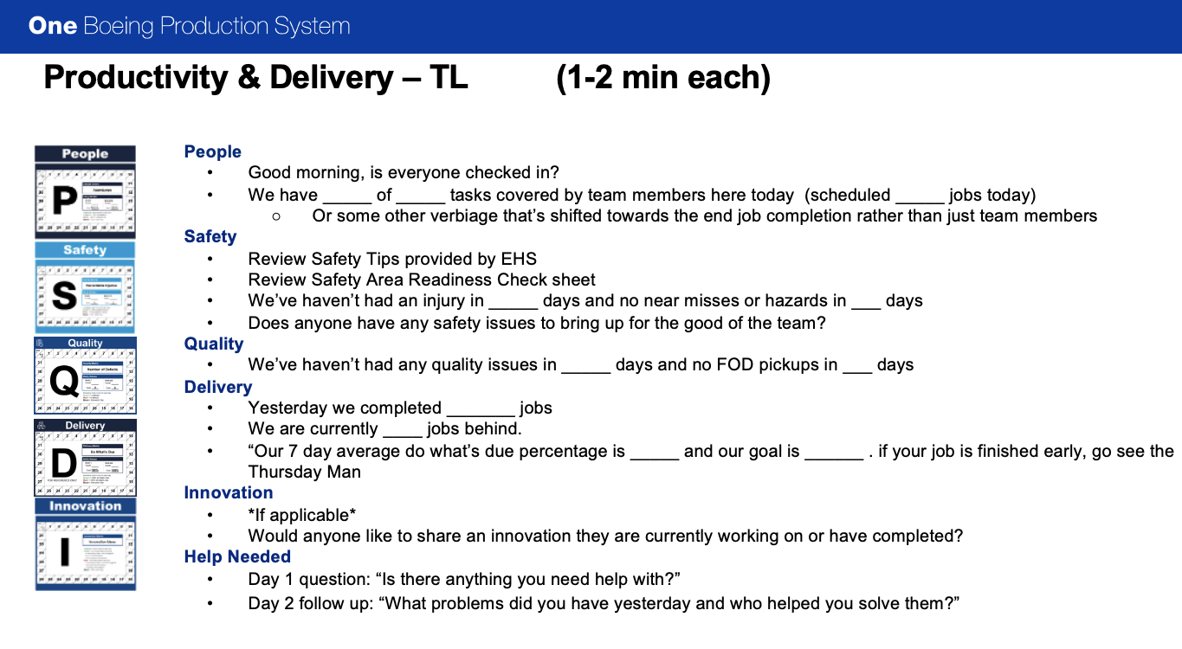
BCA Quality Inspector Optimization
Model 754: Taylor Adams, Joseph Haug, Julia Mitchell, Melinda Moehring
Problem Description
Takt Time Adjustment Results
Quality Metrics
Scenario: QA Inspectors respond to jobs as they are posted by mechanics. Currently, there are peaks of inspections at the end of the shift, resulting in inspectors working many overtime hours to complete their work.
Goal: Improve the utilization of mechanics and inspectors by increasing the spread of completed jobs throughout the shift.
Using a Simio model with mechanic jobs split into subtasks of varying lengths, the necessary working hours for inspectors were determined.
Currently, inspectors work 0.26 overtime hours/shift to complete their work.
Splitting tasks into 4 subtasks reduces hours by 1.09 hours/shift and eliminates 67.6 overtime hours/year per inspector.
Assumptions
Do What’s Due Metric
Q-Card Chart
The employees are willing to implement our ideas
No unforeseen external circumstances will affect the line
The Wing Body Joint shop is representative of the rest of the shops in the plant
Large tasks can be broken into subtasks
Inspection times are proportional to Takt time
There’s always a plane to be worked on
80% shift loading for mechanics
Inspector Allocation Tool
Process Flow Diagram
Mechanic Incentivization Results
Script Revisions
Implement more purpose-driven language
Encourage team environment
Competitive spirit towards improvement
Recommendations
Split tasks at natural break points into smaller, equivalent combined tasks.
Implement updated meeting script
Create the “Point Person” role for highly motivated and experienced Team Leads.
Point Person
Identified from “What problems did you have and who helped you solve them?”
Directs mechanics that have idle time and solves operational issues
Solution Alternatives
Future Work
Inspector Response Force (IRF)
Takt Time Adjustment
Mechanic Incentivization
Implement electronic barcharts and mechanic tablets to foster communication between QA and mechanics.
Include inspection failure in Simio model to see true benefits of IRF.
Inspector Response Force Results
Using the Simio model form the Takt Time Adjustment alternative, the benefits of an IRF was explored.
Found to have statistically insignificant improvements (time reduction of 0.03 hours per shift).
Updating thet Simio model to include failures and rework may yield more significant results.
Acknowledgements
Thank you to Brandon Gilbertson, Dr. Patty Buchanan, Dr. Ruth Huwe, and the various Boeing teams we met with for their support and guidance throughout our project!

